Slide 1

Comfy Week !
Présente

Slide 2

“A comfortable week with ComfyUI.”
“Une semaine confortable avec ComfyUI.”

Slide 3





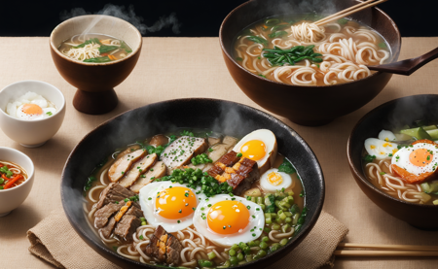

Slide 4







Slide 5

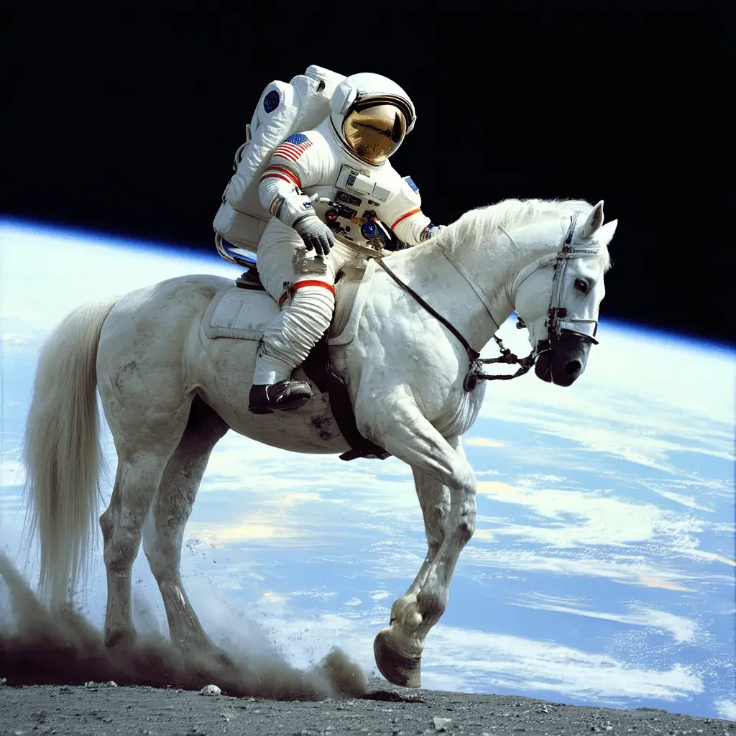



What is stable diffusion?
Stable Diffusion is a text-to-image deep learning model
Code and model weights have been released publicly
Can run on a GPU with 4 GB VRAM (<500$ hardware)
An astronaut
riding a horse

Slide 6
Stable diffusion-based projects
Fine-tuning (e.g.: Dream Shaper, Epic Realism, Realistic Vision, …)
Control Nets (with open pose, canny, depth maps, …)
IP Adapter (Image Prompt Adapter)
LoRA modifiers (Low-Rank Adaptation)
Face ID
PulID
ComfyUI

Slide 7
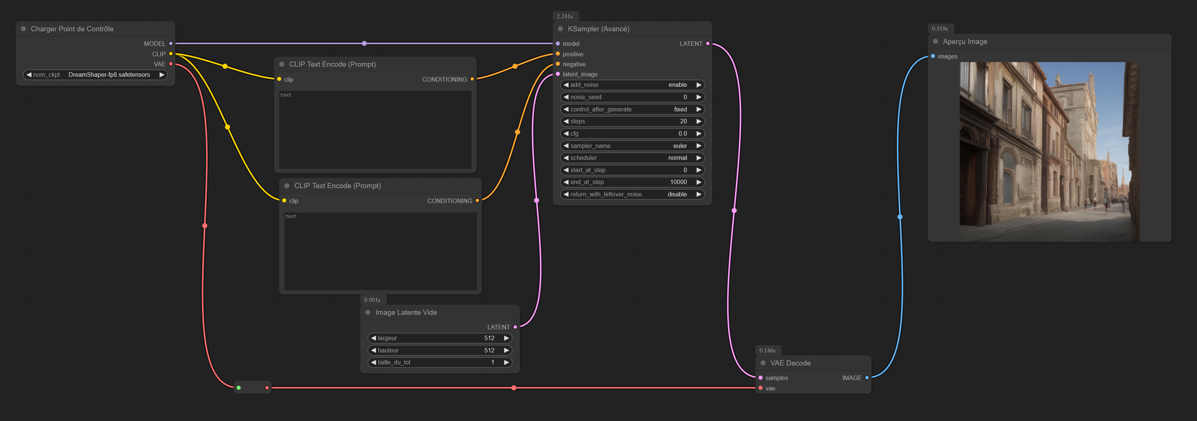
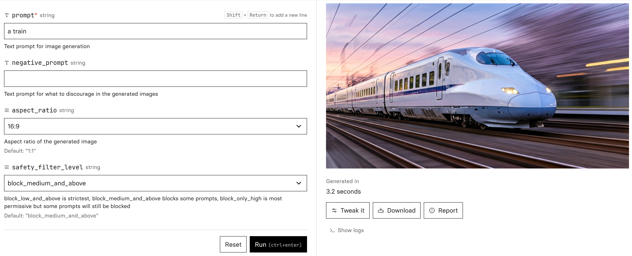
What is ComfyUI?
ComfyUI
Others (Automatic1111, etc...)
Hard-but-powerful nodal interface
Easy-to-use “click-buttons” web interface

Slide 8
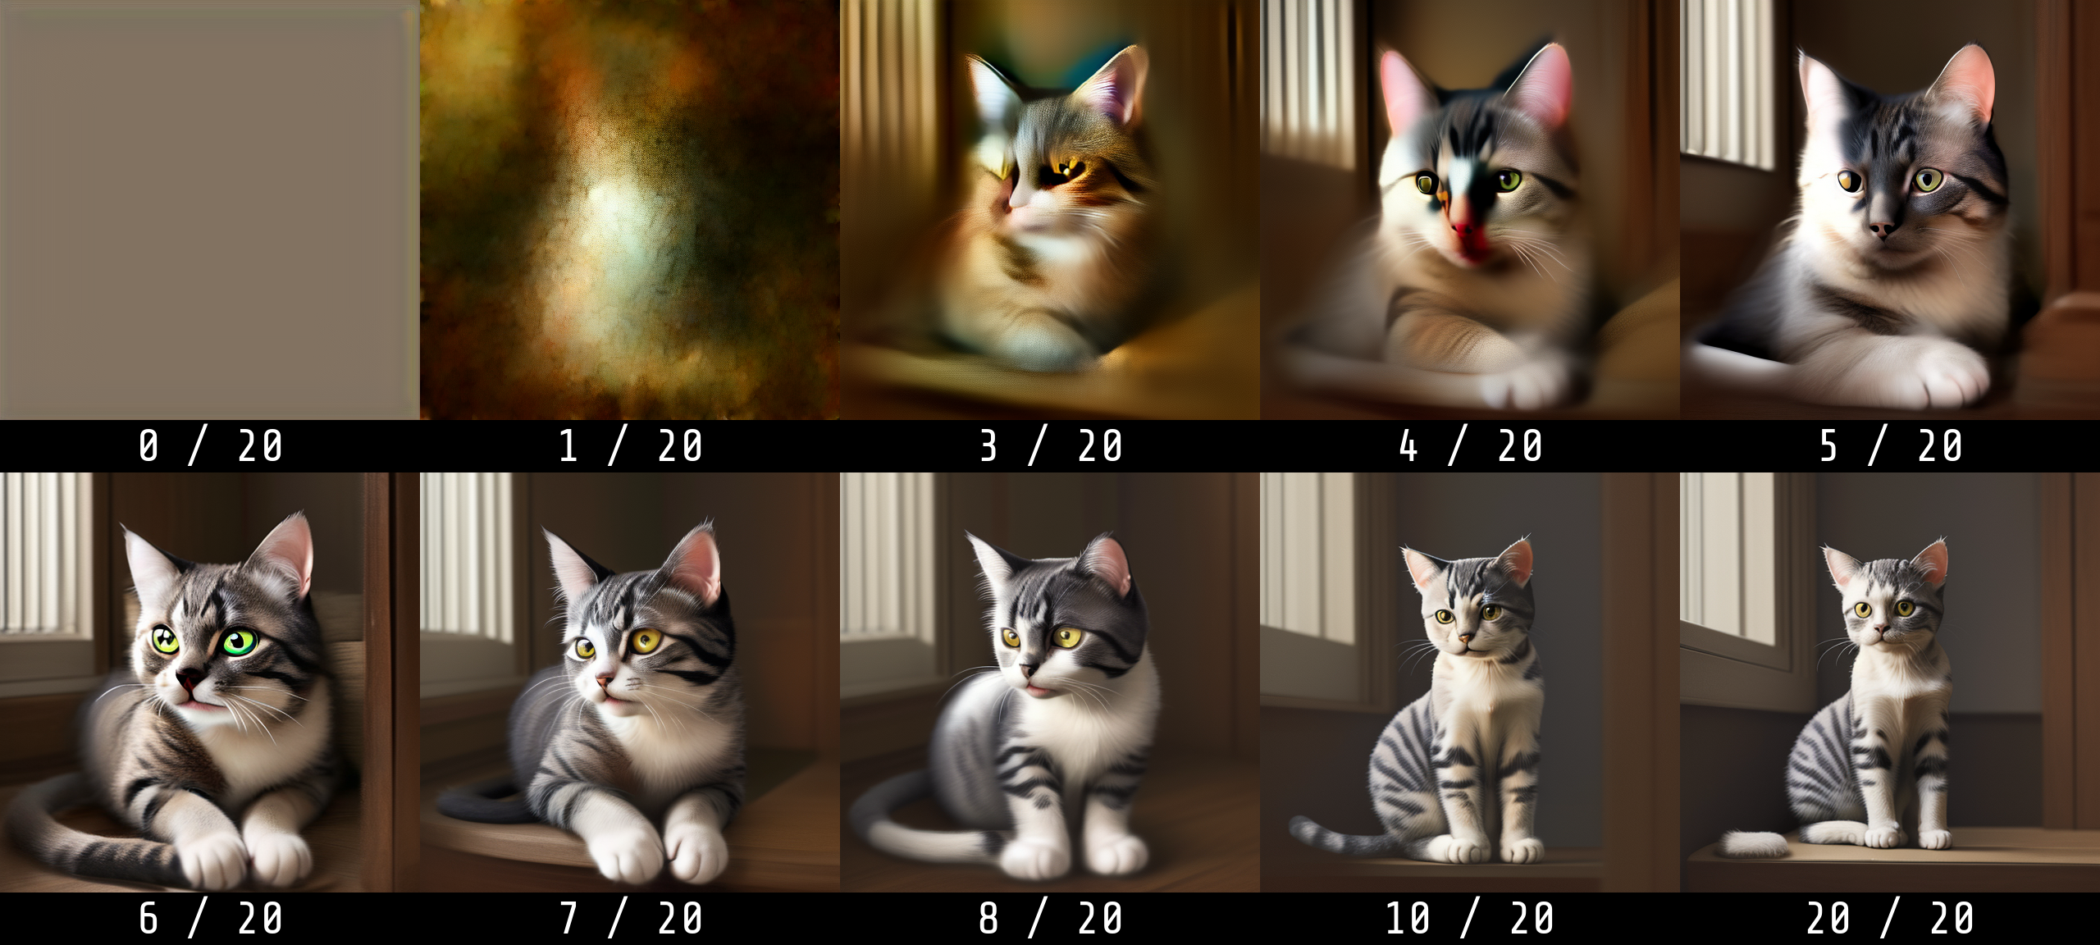
Generation step by step
Prompt: “a cat”

Slide 9

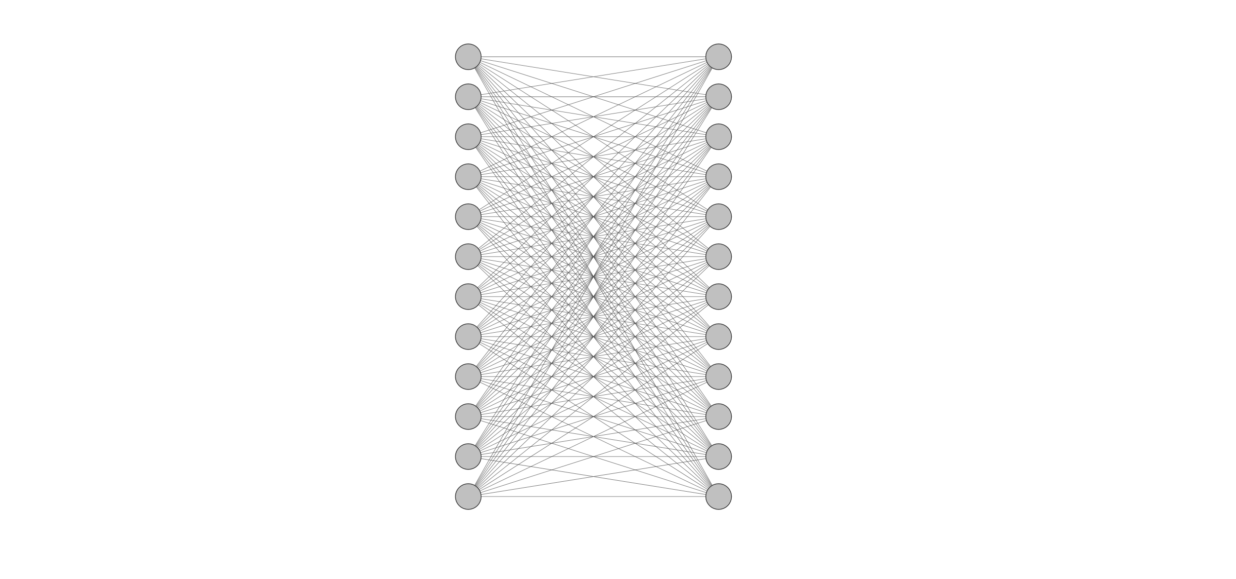
What is a machine learning / artificial intelligence model?
Small network
Big network
+ Low compute cost
- Low “intelligence”
+ High “intelligence”
- High compute cost

Slide 10


Random images vs Meaningful images

Slide 11
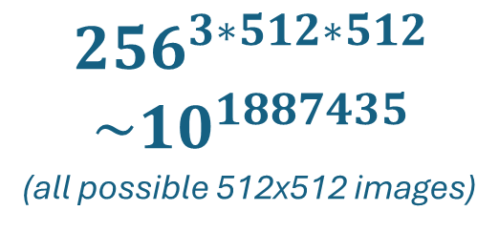
Space of images
$${256}^{3∗512∗512}$$
$$\sim 10^{1887435}$$
(all possible 512x512 images)
“Meaningful” images

Slide 12
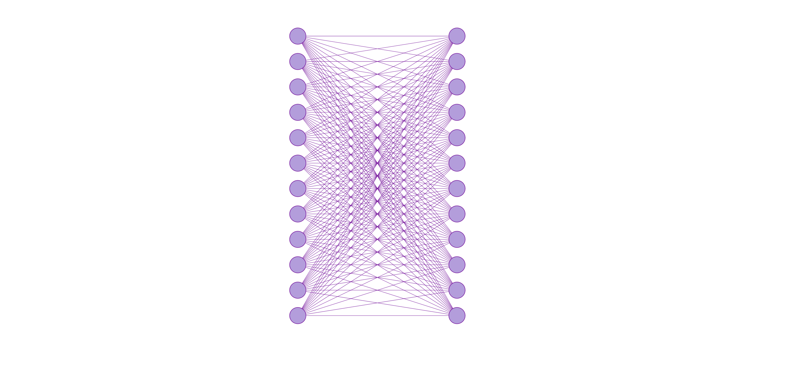

Variational Auto Encoder
VAE
Input image
Output image
Input image
Output image
(encode)
(decode)
Image-space network
Latent-space network

Slide 13
Variational Auto Encoder
(multi-steps)
VAE
Input image
Output image
Input image
(encode)
(decode)
Output image
Image-space network
Latent-space network

Slide 14
Noise prediction
Noise Prediction
Input latent
Output latent
Noise
-
Denoised latent image
Input latent
Output latent
Noisy latent image

Slide 15
Denoising sampler
Latent
Empty
Noise
Step 1
Latent
Step 1
Noise
Step 1
Latent
Step 1
Noise
Step 1
Latent
Step 1
Noise
Step 1
Latent
Step 1
Neuron
value

Slide 16



Sampler
Euler
DPM++2M
LCM

Slide 17
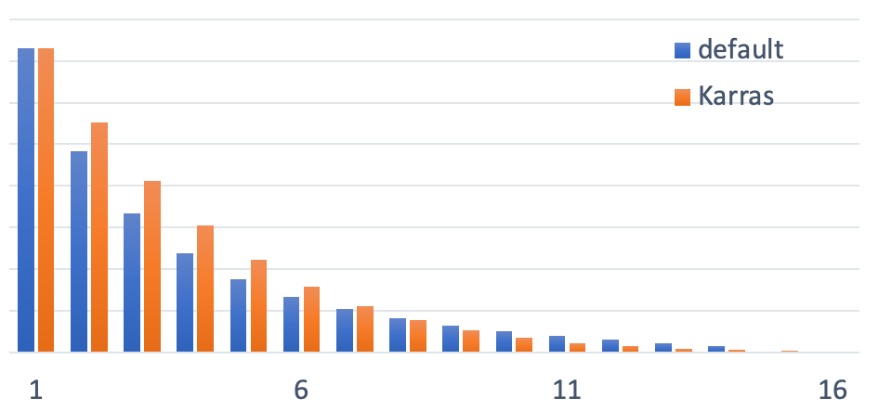
Noise Schedule

Slide 18




Noise scheduler
Normal
Karras
Exponential
SGM
Uniform

Slide 19
Noise scheduler
Normal
Karras
Exponential

Slide 20
Prompting the model
Denoised (no prompt)
Input latent
Output latent
-
Denoised (re-enforced prompted)
Input latent
Output latent
Latent
Denoised (prompted)
Prompt

